Slide 1
House Rent Prediction
Aishwarya R
Batch-7230

Slide 2
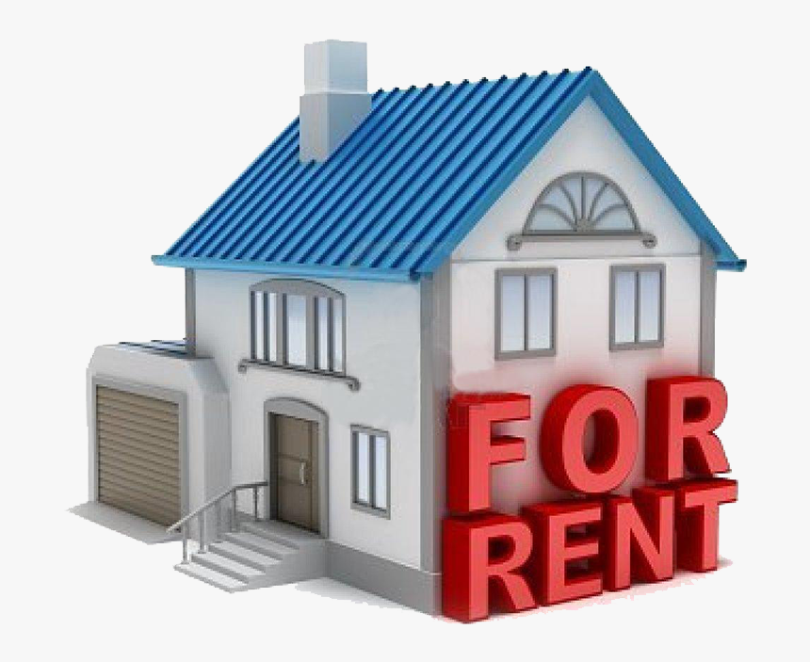
Objective
The aim of the project is to build a machine learning model to predict the rent price of homes based on different explanatory variables describing aspects of residential houses.

Slide 3
Introduction
Problems faced during buying a house.
Buying a house is a stressfull thing.
Many problems are faced during buying a house
Hence agents are trusted with the communication between buyers and sellers as well as laying down a legal contract for the transfer.This just creates a middle man and increases the cost of houses.

Slide 4
Structure of dataset
BHK - Number of Bedrooms, Hall, Kitchen
Rent - Price of the Houses/Apartments/Flats
Size - Size of the Houses/Apartments/Flats in Square Feet
Floor - Houses/Apartments/Flats situated in which Floor and Total Number of Floors
Area Type - Size of the Houses/Apartments/Flats calculated on
Area Locality - Locality of the Houses/Apartments/Flats
City - City where the Houses/Apartments/Flats are Located
Furnishing Status - Furnishing Status of the Houses/Apartments/Flats
Tenant Preferred - Type of Tenant Preferred by the Owner or Agent
Bathroom - Number of Bathrooms
Point of Contact - Whom should you contact for more information regarding the Houses/Apartments/Flats

Slide 5
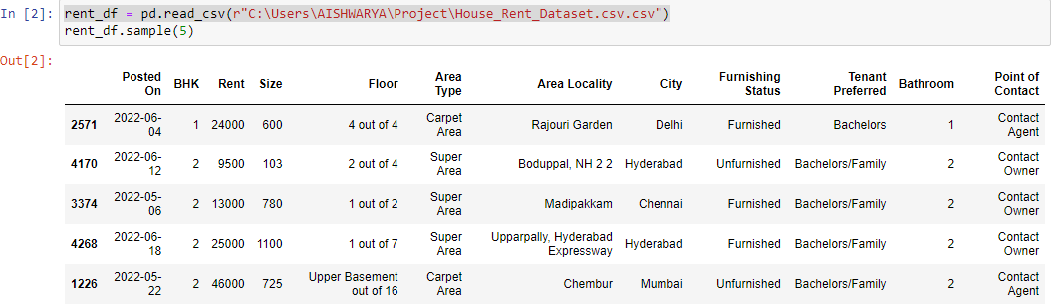
Data Loading

Slide 6
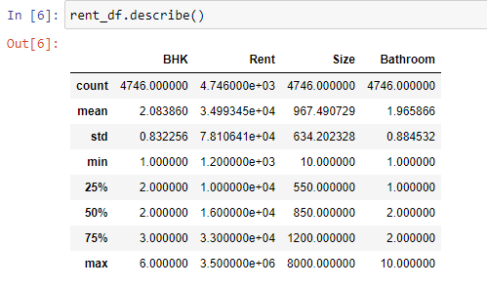
Describing Data

Slide 7
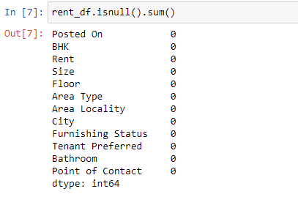
Cleaning Data

Slide 8
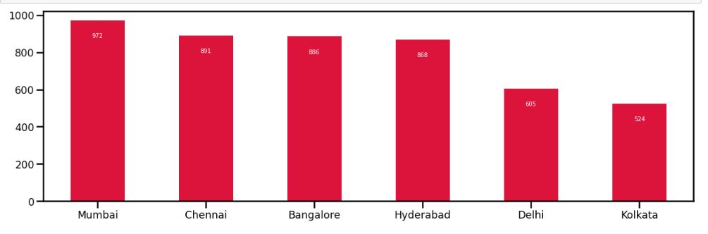
Bar Plot for Number of House in Each City which is Available for Rent

Slide 9
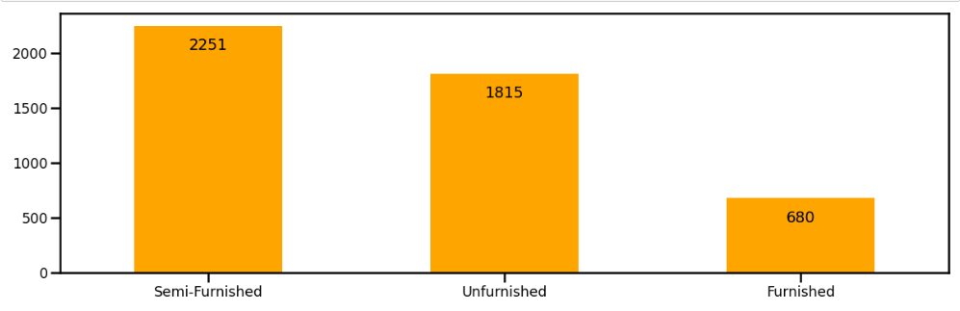
Bar Plot on Different Types of Furnishing Status

Slide 10
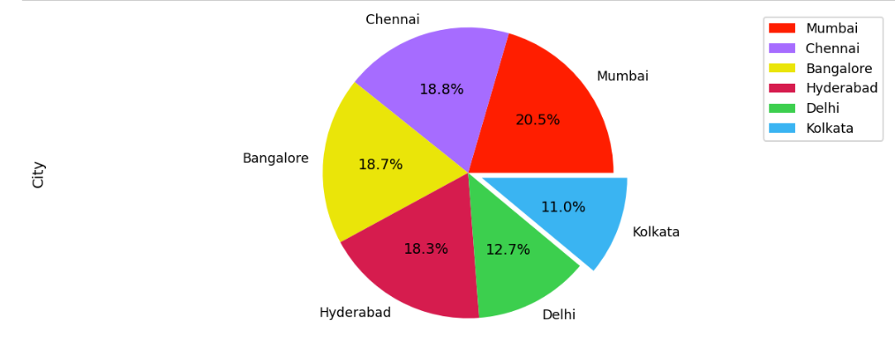
Pie Plot on Cities to check the distribution

Slide 11
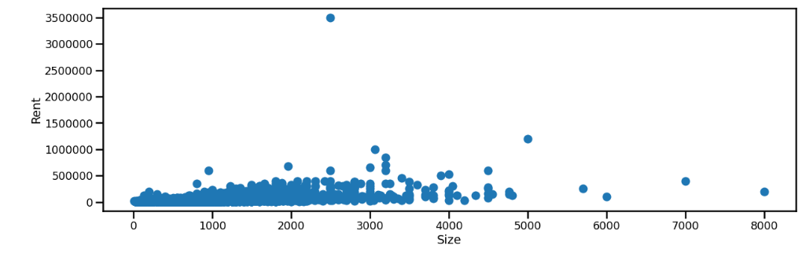
Scatter Plot on House Rents v/s House Sizes

Slide 12
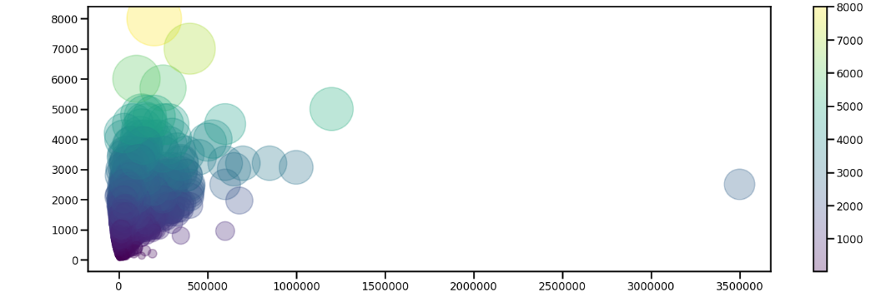
Relationship between House Rent v/s House Sizes

Slide 13
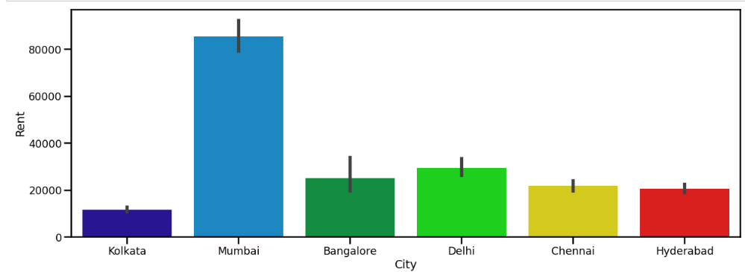
Bar Plot for City v/s House Rent

Slide 14
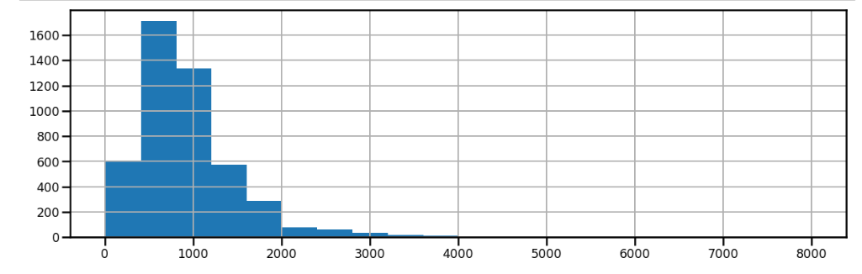
Histogram on House Sizes

Slide 15
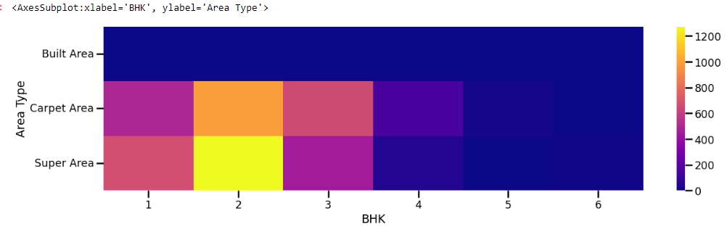
Heatmap for Areatype

Slide 16
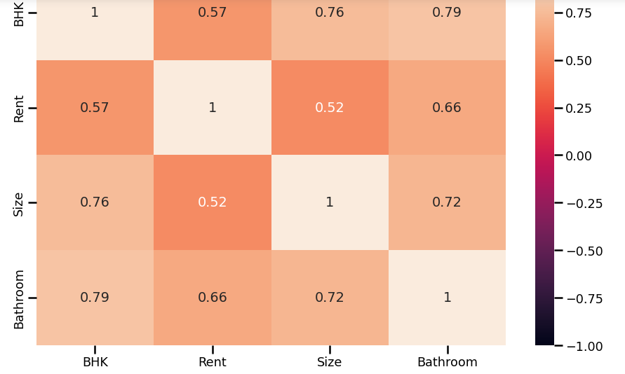
Correlation Heatmap

Slide 17
Random Forest Classifier
Random forest is a supervised machine learning
algorithm made up of decision trees.
Random forest algorithm can be applied for both classification and regression.
Random forest runs efficiently on a large data set.

Slide 18
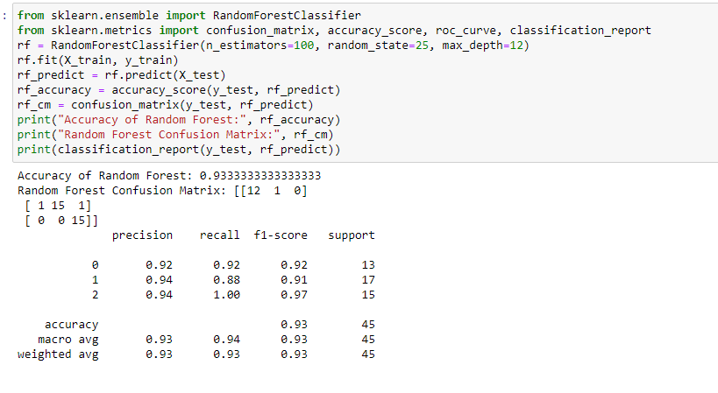
Evaluate Model

Slide 19
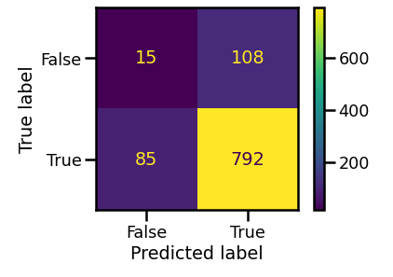
Confusion matrix

Slide 20
Conclusion
The Prediction gave a idea about the community’s opinions surrounding affordable housing.
In this project for the purpose of predicting the rental price and we have used Random forest classifier
The Accuracy of Random forest classifier is 0.9333%
that is 93%

Slide 21
Thank you

